Slide 1



Driver Distraction Detection System Using Arduino Nicla Vision
Eng. Zyad Rashed Alzahrani
Eng. Abdulhadi Bashathi
Eng. Jawad Abed Maimani
Eng. Aws Alsaedi

Slide 2
Problem statement
Driver distraction is a major cause of road accidents worldwide. The increasing use of smartphones, in-car entertainment, and other devices often diverts drivers' attention from the road, leading to delayed reactions, impaired decisions, and preventable accidents. Distraction refers to any activity that takes a driver’s focus away from safely operating the vehicle.
Detect if the cell phone is using while drive
Detect If the driver is smoking while drive
Detect if the driver holding the steering wheel or not
1

Slide 3
System Overview
The system will utilize the Arduino Nicla Vision with its integrated camera to continuously capture the driver’s actions. Advanced computer vision and machine learning algorithms will analyze the driver’s gestures, hand positions, and interactions with objects (like a phone or cigarette). When a distraction is detected, the system will trigger an alert ( auditory) to warn the driver.
Object Detection Model (TensorFlow Lite / YOLO) to detect cigarette and cell phone.
MediaPipe Hand Tracking to track the driver hand position
2

Slide 4
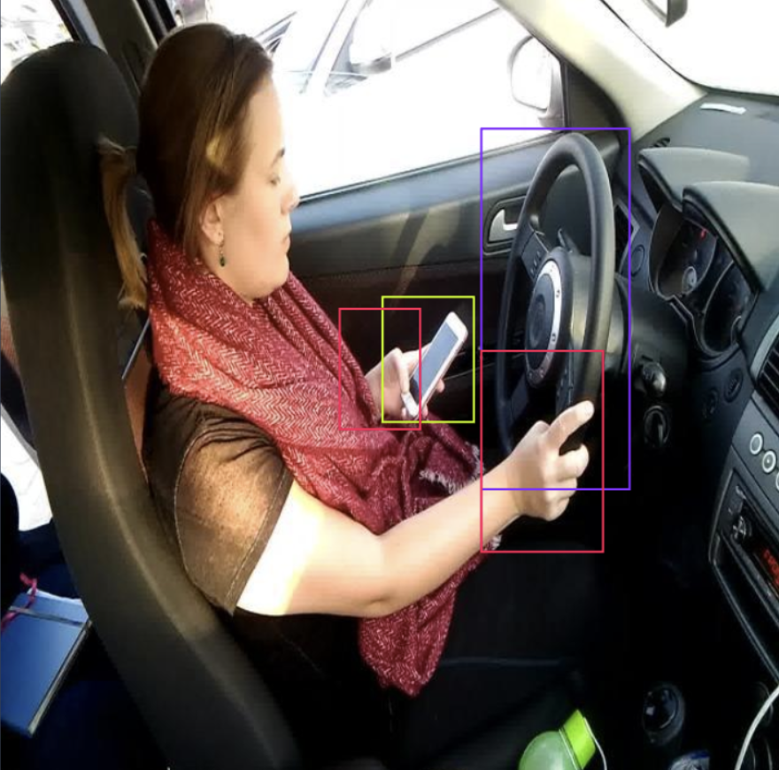
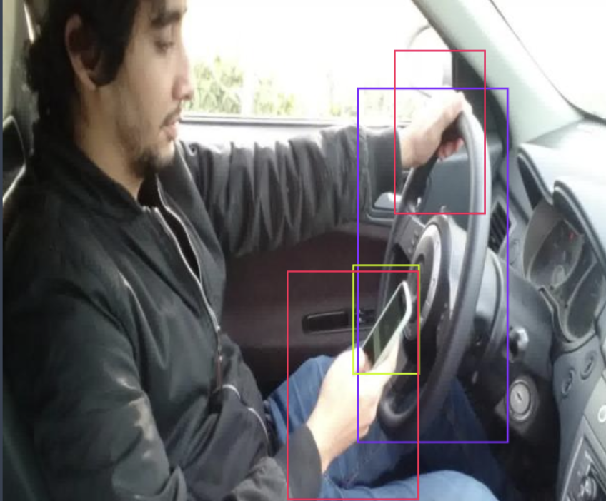

6

